Slide 1
RUSTikales Rust for beginners
©Philippe Felix Haupt 2023

Slide 2
Plan for today
©Philippe Felix Haupt 2023

Slide 3
Plan for today
Introduction
©Philippe Felix Haupt 2023

Slide 4
Plan for today
Introduction
What will we be learning this semester?
©Philippe Felix Haupt 2023

Slide 5
Plan for today
Introduction
What will we be learning this semester?
Where can I find resources?
©Philippe Felix Haupt 2023

Slide 6
Plan for today
Introduction
What will we be learning this semester?
Where can I find resources?
Rust Installation
©Philippe Felix Haupt 2023

Slide 7
Plan for today
Introduction
What will we be learning this semester?
Where can I find resources?
Rust Installation
Linux
©Philippe Felix Haupt 2023

Slide 8
Plan for today
Introduction
What will we be learning this semester?
Where can I find resources?
Rust Installation
Linux
Windows
©Philippe Felix Haupt 2023

Slide 9
Plan for today
Introduction
What will we be learning this semester?
Where can I find resources?
Rust Installation
Linux
Windows
Setting up a development environment
©Philippe Felix Haupt 2023

Slide 10
Plan for today
Introduction
What will we be learning this semester?
Where can I find resources?
Rust Installation
Linux
Windows
Setting up a development environment
Visual Studio Code
©Philippe Felix Haupt 2023

Slide 11
Plan for today
Introduction
What will we be learning this semester?
Where can I find resources?
Rust Installation
Linux
Windows
Setting up a development environment
Visual Studio Code
rust-analyzer
©Philippe Felix Haupt 2023

Slide 12
Plan for today
Introduction
What will we be learning this semester?
Where can I find resources?
Rust Installation
Linux
Windows
Setting up a development environment
Visual Studio Code
rust-analyzer
General Info
©Philippe Felix Haupt 2023

Slide 13
Introduction
Some small surveys so I get to know you better
PINGO
©Philippe Felix Haupt 2023

Slide 14
Introduction
Some small surveys so I get to know you better
PINGO
Welcome at the TU Dresden!
©Philippe Felix Haupt 2023

Slide 15
Introduction
Some small surveys so I get to know you better
PINGO
Welcome at the TU Dresden!
Welcome in this Rust course!
©Philippe Felix Haupt 2023

Slide 16
Introduction
Some small surveys so I get to know you better
PINGO
Welcome at the TU Dresden!
Welcome in this Rust course!
Your life will change forever soon, you will be learning the best language in the world!!!
It’s memory safe!
It’s statically typed!
It’s fast!
Zero Cost Abstraction!
©Philippe Felix Haupt 2023

Slide 17
Introduction
Some small surveys so I get to know you better
PINGO
Welcome at the TU Dresden!
Welcome in this Rust course!
Your life will change forever soon, you will be learning the best language in the world!!!
Well, not quite, but you’ll see once we get there
©Philippe Felix Haupt 2023

Slide 18
1.a. What will we be learning this semester?
©Philippe Felix Haupt 2023

Slide 19
1.a. What will we be learning this semester?
working with the Rust compiler `rustc`
©Philippe Felix Haupt 2023

Slide 20
1.a. What will we be learning this semester?
working with the Rust compiler `rustc`
working with the Rust tool `cargo`
©Philippe Felix Haupt 2023

Slide 21
1.a. What will we be learning this semester?
working with the Rust compiler `rustc`
working with the Rust tool `cargo`
`cargo init`
`cargo build`
`cargo run`
`cargo fmt`
`cargo clippy`
`cargo test`
`cargo install`
©Philippe Felix Haupt 2023

Slide 22

1.a. What will we be learning this semester?
working with the Rust compiler `rustc`
working with the Rust tool `cargo`
`cargo init`
`cargo build`
`cargo run`
`cargo fmt`
`cargo clippy`
`cargo test`
`cargo install`
©Philippe Felix Haupt 2023

Slide 23
1.a. What will we be learning this semester?
working with the Rust compiler `rustc`
working with the Rust tool `cargo`
`cargo init`
`cargo build`
`cargo run`
`cargo fmt`
`cargo clippy`
`cargo test`
`cargo install`
Don’t worry, we’ll not be covering them in detail. All you need to know is that they exist, and what they do in general. We neither have enough time, nor is it suited for beginners to cover `cargo` in depth.
©Philippe Felix Haupt 2023

Slide 24

1.a. What will we be learning this semester?
working with the Rust compiler `rustc`
working with the Rust tool `cargo`
`cargo init`
`cargo build`
`cargo run`
`cargo fmt`
`cargo clippy`
`cargo test`
`cargo install`
Don’t worry, we’ll not be covering them in detail. All you need to know is that they exist, and what they do in general. We neither have enough time, nor is it suited for beginners to cover `cargo` in depth.
For now, extensions and IDEs will help us through this mist of tools
©Philippe Felix Haupt 2023

Slide 25
1.a. What will we be learning this semester?
working with the Rust compiler `rustc`
working with the Rust tool `cargo`
`cargo init`
`cargo build`
`cargo run`
`cargo fmt`
`cargo clippy`
`cargo test`
`cargo install`
Don’t worry, we’ll not be covering them in detail. All you need to know is that they exist, and what they do in general. We neither have enough time, nor is it suited for beginners to cover `cargo` in depth.
For now, extensions and IDEs will help us through this mist of tools, most notably:
Visual Studio Code + rust-analyzer
CLion ← JetBrains Student Pack, free ultimate version!
©Philippe Felix Haupt 2023

Slide 26
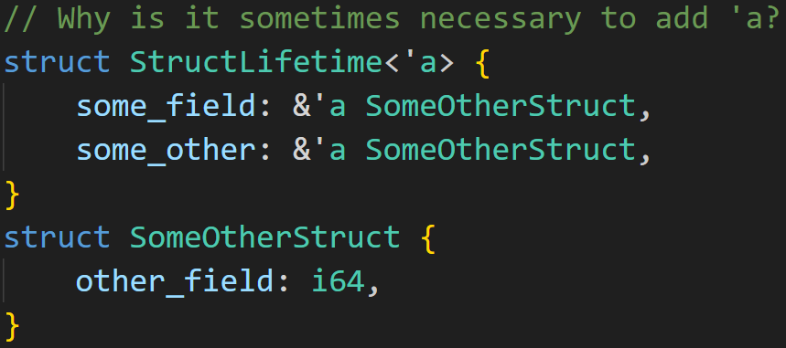
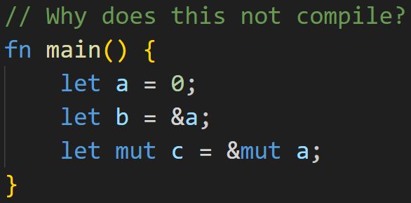
1.a. What will we be learning this semester?
working with the Rust compiler `rustc`
working with the Rust tool `cargo`
`cargo init`
`cargo build`
`cargo run`
`cargo fmt`
`cargo clippy`
`cargo test`
`cargo install`
Don’t worry, we’ll not be covering them in detail. All you need to know is that they exist, and what they do in general. We neither have enough time, nor is it suited for beginners to cover `cargo` in depth.
For now, extensions and IDEs will help us through this mist of tools, most notably:
Visual Studio Code + rust-analyzer
CLion ← JetBrains Student Pack, free ultimate version!
Basic Rust (Borrow Checking and Lifetimes)
©Philippe Felix Haupt 2023

Slide 27
1.a. What will we be learning this semester?
working with the Rust compiler `rustc`
working with the Rust tool `cargo`
`cargo init`
`cargo build`
`cargo run`
`cargo fmt`
`cargo clippy`
`cargo test`
`cargo install`
Don’t worry, we’ll not be covering them in detail. All you need to know is that they exist, and what they do in general. We neither have enough time, nor is it suited for beginners to cover `cargo` in depth.
For now, extensions and IDEs will help us through this mist of tools, most notably:
Visual Studio Code + rust-analyzer
CLion ← JetBrains Student Pack, free ultimate version!
Basic Rust (Borrow Checking and Lifetimes)
Control Flow: `if`, `while`, `match`
©Philippe Felix Haupt 2023

Slide 28
1.a. What will we be learning this semester?
working with the Rust compiler `rustc`
working with the Rust tool `cargo`
`cargo init`
`cargo build`
`cargo run`
`cargo fmt`
`cargo clippy`
`cargo test`
`cargo install`
Don’t worry, we’ll not be covering them in detail. All you need to know is that they exist, and what they do in general. We neither have enough time, nor is it suited for beginners to cover `cargo` in depth.
For now, extensions and IDEs will help us through this mist of tools, most notably:
Visual Studio Code + rust-analyzer
CLion ← JetBrains Student Pack, free ultimate version!
Basic Rust (Borrow Checking and Lifetimes)
Control Flow: `if`, `while`, `match`
Custom Types: `struct`, `enum`
©Philippe Felix Haupt 2023

Slide 29
1.a. What will we be learning this semester?
working with the Rust compiler `rustc`
working with the Rust tool `cargo`
`cargo init`
`cargo build`
`cargo run`
`cargo fmt`
`cargo clippy`
`cargo test`
`cargo install`
Don’t worry, we’ll not be covering them in detail. All you need to know is that they exist, and what they do in general. We neither have enough time, nor is it suited for beginners to cover `cargo` in depth.
For now, extensions and IDEs will help us through this mist of tools, most notably:
Visual Studio Code + rust-analyzer
CLion ← JetBrains Student Pack, free ultimate version!
Basic Rust (Borrow Checking and Lifetimes)
Control Flow: `if`, `while`, `match`
Custom Types: `struct`, `enum`
Option<T>, Result<V, E> and other useful data structures
©Philippe Felix Haupt 2023

Slide 30
1.a. What will we be learning this semester?
working with the Rust compiler `rustc`
working with the Rust tool `cargo`
`cargo init`
`cargo build`
`cargo run`
`cargo fmt`
`cargo clippy`
`cargo test`
`cargo install`
Don’t worry, we’ll not be covering them in detail. All you need to know is that they exist, and what they do in general. We neither have enough time, nor is it suited for beginners to cover `cargo` in depth.
For now, extensions and IDEs will help us through this mist of tools, most notably:
Visual Studio Code + rust-analyzer
CLion ← JetBrains Student Pack, free ultimate version!
What I will not be covering:
`unsafe`
`async`
Macros (maybe if we still have time in the end)
Multithreading
Rust-idiomatic functional programming approaches (filter, map, fold…)
How to build an OS with Rust
©Philippe Felix Haupt 2023

Slide 31
1.b. Where can I find resources?
Official Rust website:
https://www.rust-lang.org/learn/
Rust Book:
https://doc.rust-lang.org/book/
Rustlings (official Rust exercises):
https://rustlings.cool/
Repo for this course:
https://github.com/pfhaupt/progkurs/
subdirectory `rust-beginner`
©Philippe Felix Haupt 2023

Slide 32
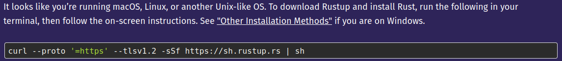
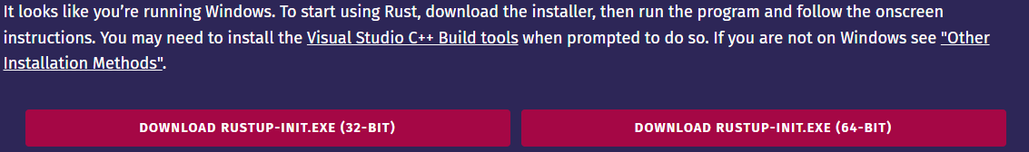
2. Rust Installation
Linux/macOS
Go to `rust-lang.org`
Click `Get Started`
Run this command in your terminal
You may need to also install a linker
you’ll see later when the example fails
You’re ready to go!
Windows
Go to `rust-lang.org`
Click `Get Started`
Download the Installer
Run the Installer
You may need to also install MSVC Tools
Installer will tell you, Quick Install is okay
Pray that eduroam doesn’t blacklist the MSVC Installer again :^)
Note: I wasn’t able to find a macOS-ISO for a VM, so I couldn’t test the installation process :^) For all things considered in this setup, macOS is basically Linux.
©Philippe Felix Haupt 2023

Slide 33
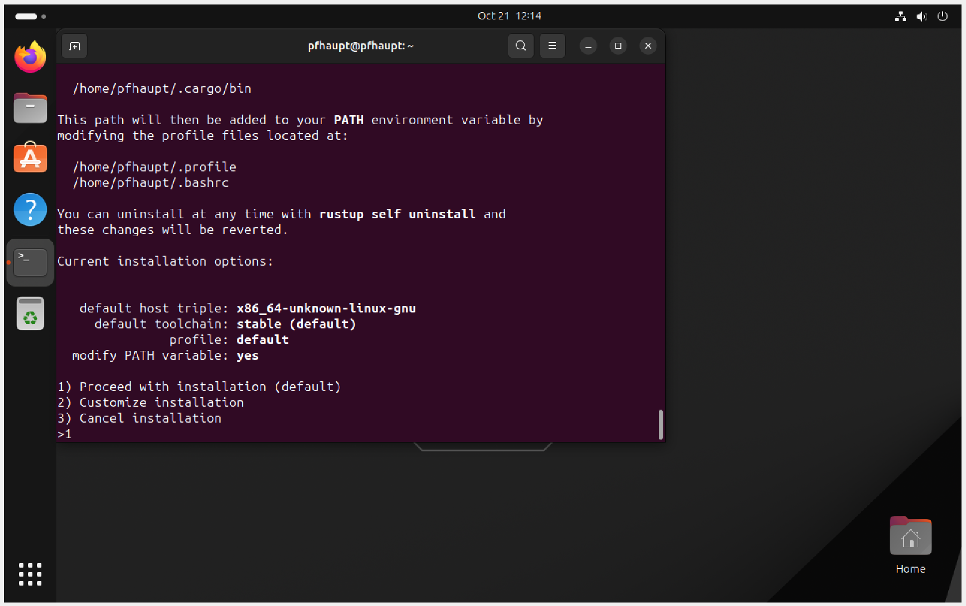
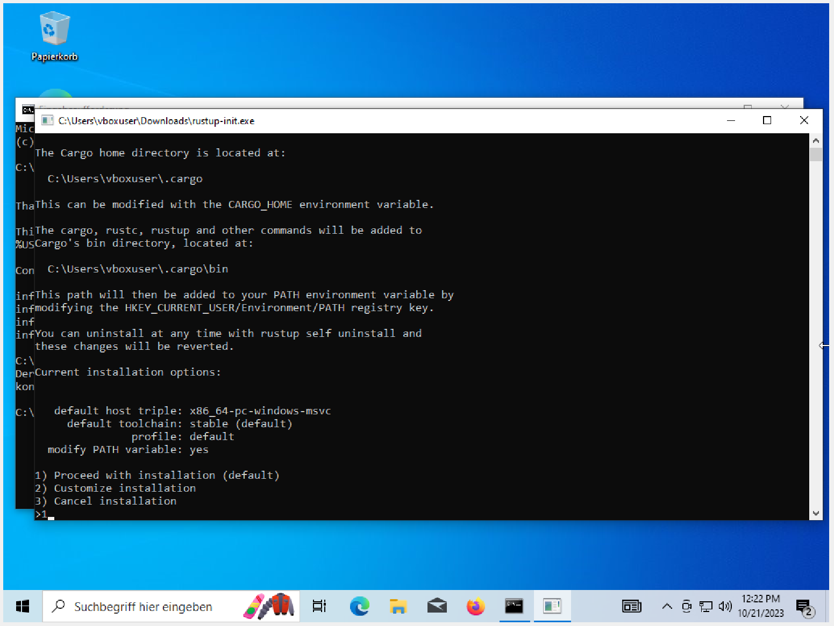
2. Rust Installation
Linux
Windows
If you see this, you’re almost done! It will now install all necessary tools.
Restart your terminal/console, and you’ll be able to use `rustc` and `cargo`!
©Philippe Felix Haupt 2023

Slide 34
2. Rust Installation
if Installation was successful, you should be able to run the following commands:
©Philippe Felix Haupt 2023

Slide 35

2. Rust Installation
if Installation was successful, you should be able to run the following commands:
©Philippe Felix Haupt 2023

Slide 36
2. Rust Installation
if Installation was successful, you should be able to run the following commands:
©Philippe Felix Haupt 2023

Slide 37
2. Rust Installation
if Installation was successful, you should be able to run the following commands:
©Philippe Felix Haupt 2023

Slide 38
2. Rust Installation
if Installation was successful, you should be able to run the following commands:
Has everyone gotten to this point?
Very important moment right here!
©Philippe Felix Haupt 2023

Slide 39
2. Rust Installation
To test if everything is set up properly, run those commands:
Create a directory of your choice, and `cd` there
`cargo init test_program`
`cd test_program`
`cargo run`
if you see “Hello, world!”, you’re ready to go!
©Philippe Felix Haupt 2023

Slide 40
2. Rust Installation
To test if everything is set up properly, run those commands:
Create a directory of your choice, and `cd` there
`cargo init test_program`
`cd test_program`
`cargo run`
if you see “Hello, world!”, you’re ready to go!
IF NOT: Please raise your hand now, you’ll not be able to properly use Rust otherwise!
©Philippe Felix Haupt 2023

Slide 41
2. Rust Installation
To test if everything is set up properly, run those commands:
Create a directory of your choice, and `cd` there
`cargo init test_program`
`cd test_program`
`cargo run`
if you see “Hello, world!”, you’re ready to go!
IF NOT: Please raise your hand now, you’ll not be able to properly use Rust otherwise!
The only error I found when trying on fresh VMs:
On Linux → `Linker cc not found` → `sudo apt install gcc`, restart terminal, try again
On Windows → eduroam may block downloading the Installer → you’d need to try again at home :^)
Doesn’t mean there are no other errors, please tell me if you found something else!
©Philippe Felix Haupt 2023

Slide 42
Pew, that was a lot!
But everything is now set up properly.
Time to take a small break.
©Philippe Felix Haupt 2023

Slide 43
3. Development Environment
©Philippe Felix Haupt 2023

Slide 44
3. Development Environment
Technically it doesn’t matter, you could even use Ed, Notepad, Word…
©Philippe Felix Haupt 2023

Slide 45
3. Development Environment
Technically it doesn’t matter, you could even use Ed, Notepad, Word…
There are some IDEs and Editors that make programming [in Rust] easier
©Philippe Felix Haupt 2023

Slide 46
3. Development Environment
Technically it doesn’t matter, you could even use Ed, Notepad, Word…
There are some IDEs and Editors that make programming [in Rust] easier:
JetBrains CLion ← License is free for students with a TU-email
Emacs, Vim ← For those who prefer terminal editors
Visual Studio Code ← What I’ll be using
©Philippe Felix Haupt 2023

Slide 47
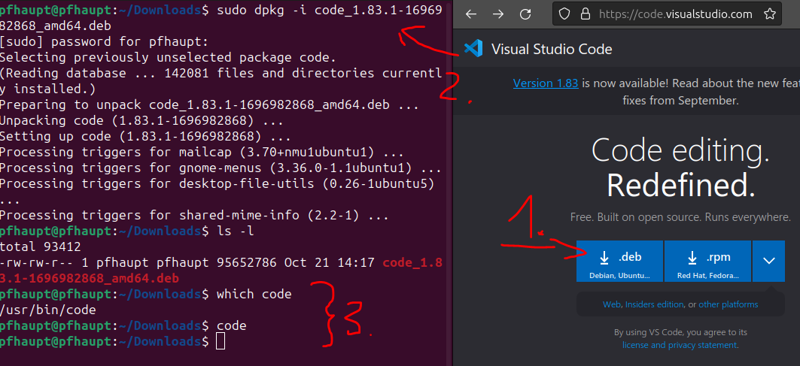
3. Development Environment
Technically it doesn’t matter, you could even use Ed, Notepad, Word…
There are some IDEs and Editors that make programming [in Rust] easier:
JetBrains CLion ← License is free for students with a TU-email
Emacs, Vim ← For those who prefer terminal editors
Visual Studio Code ← What I’ll be using
VSC → https://code.visualstudio.com/
On Windows, just follow the installer
On Linux:
Disclaimer: I am not a Linux main (yet), if there’s a simpler way, please tell me :^)
©Philippe Felix Haupt 2023

Slide 48
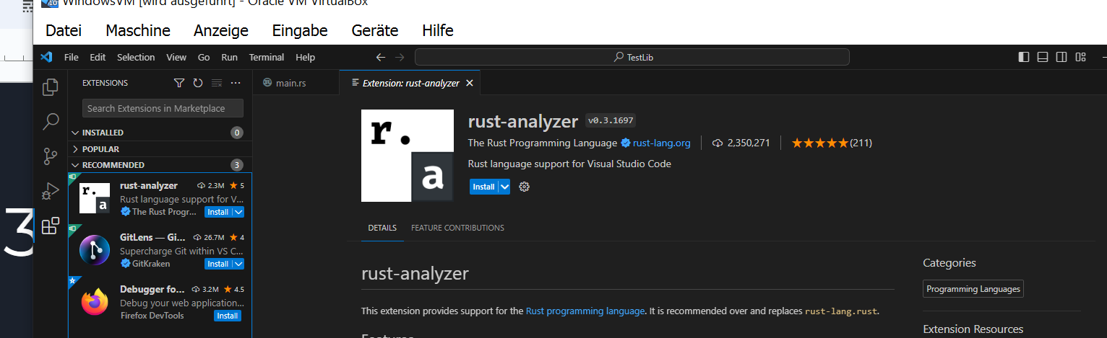
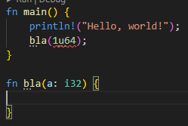
3. Development Environment
Visual Studio Code itself does not have built in Rust support
Built in Syntax Highlighting, but no Language Server (no red wiggly lines and warnings)
That’s what rust-analyzer is for
official extension by the Rust foundation
also allows you to run and debug your code from within VSC, no `cargo run` needed
©Philippe Felix Haupt 2023

Slide 49
4. General Info
Starting this session, I will put the slides on the Github repository
©Philippe Felix Haupt 2023

Slide 50
4. General Info
Starting this session, I will put the slides on the Github repository
Starting next session, I will put exercises on the Github repository
Can’t really exercise Rust installation :^)
©Philippe Felix Haupt 2023

Slide 51
4. General Info
Starting this session, I will put the slides on the Github repository
Starting next session, I will put exercises on the Github repository
Can’t really exercise Rust installation :^)
Exercises and code snippets in future slides will be color-coded and rated:
©Philippe Felix Haupt 2023

Slide 52
4. General Info
Starting this session, I will put the slides on the Github repository
Starting next session, I will put exercises on the Github repository
Can’t really exercise Rust installation :^)
Exercises and code snippets in future slides will be color-coded and rated:
0/3 → Green → we covered the topic of the exercise in the past, should be easy
©Philippe Felix Haupt 2023

Slide 53
4. General Info
Starting this session, I will put the slides on the Github repository
Starting next session, I will put exercises on the Github repository
Can’t really exercise Rust installation :^)
Exercises and code snippets in future slides will be color-coded and rated:
0/3 → Green → we covered the topic of the exercise in the past, should be easy
1/3 → Yellow → we covered the topic of the exercise in that session, may be hard
©Philippe Felix Haupt 2023

Slide 54
4. General Info
Starting this session, I will put the slides on the Github repository
Starting next session, I will put exercises on the Github repository
Can’t really exercise Rust installation :^)
Exercises and code snippets in future slides will be color-coded and rated:
0/3 → Green → we covered the topic of the exercise in the past, should be easy
1/3 → Yellow → we covered the topic of the exercise in that session, may be hard
2/3 → Red → same as yellow, but even more difficult
©Philippe Felix Haupt 2023

Slide 55
4. General Info
Starting this session, I will put the slides on the Github repository
Starting next session, I will put exercises on the Github repository
Can’t really exercise Rust installation :^)
Exercises and code snippets in future slides will be color-coded and rated:
0/3 → Green → we covered the topic of the exercise in the past, should be easy
1/3 → Yellow → we covered the topic of the exercise in that session, may be hard
2/3 → Red → same as yellow, but even more difficult
3/3 → Purple → we have not yet covered the topic, but you want to try and learn on your own
©Philippe Felix Haupt 2023

Slide 56
4. General Info
In the beginning of each session, we’ll be going over the exercises, compare the results, and I’ll answer your questions
©Philippe Felix Haupt 2023

Slide 57
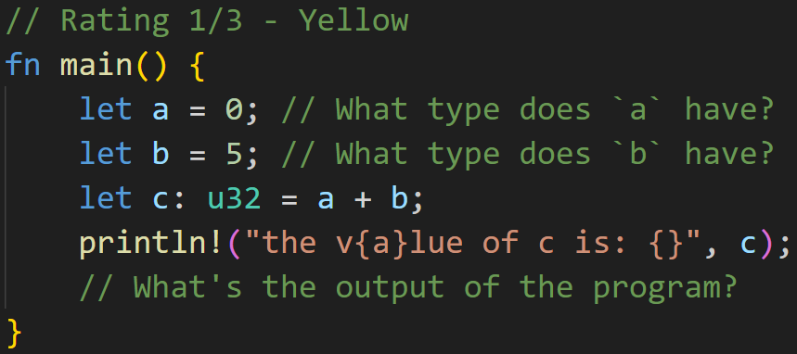
4. General Info
In the beginning of each session, we’ll be going over the exercises, compare the results, and I’ll answer your questions
An exercise may look like this:
©Philippe Felix Haupt 2023

Slide 58
4. General Info
In the beginning of each session, we’ll be going over the exercises, compare the results, and I’ll answer your questions
An exercise may look like this:
Does anyone know already?
©Philippe Felix Haupt 2023

Slide 59
4. General Info
In the beginning of each session, we’ll be going over the exercises, compare the results, and I’ll answer your questions
An exercise may look like this:
Does anyone know already?
type of a → u32 (unsigned 32 bit integer)
type of b → u32 (unsigned 32 bit integer)
output → `the v0lue of c is: 5` ← `{a}` is part of the format syntax, so it turns into the value of `a`!
©Philippe Felix Haupt 2023

Slide 60
4. General Info
Feedback:
too slow
too fast
too quiet
too loud
too understandable
too perfect
too unclear
errors in my slides
errors in my examples
etcetc
→ Feel free to send me an email, or talk to me after the session!
→ Has been a long time since I was a beginner, so I may sometimes underestimate the difficulty of programming, especially in Rust :^)
©Philippe Felix Haupt 2023

